Slide 1
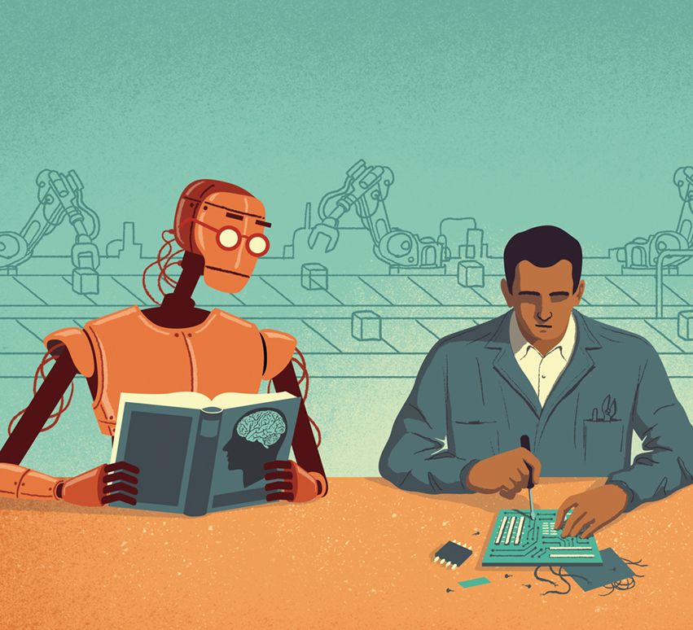
Machine learning for beginners
Hala Raslan

Slide 2
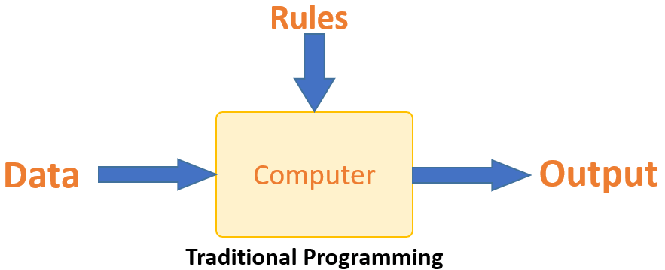
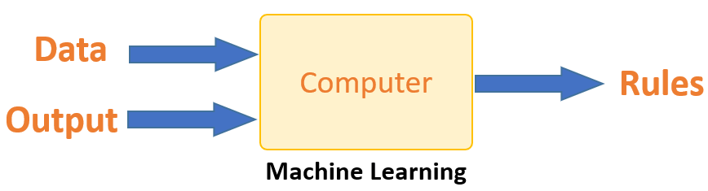
What is machine learning?
Machine learning vs Traditional programming
Main idea: Machines can learn from data to produce accurate results
ML gives the ability for a computer to self-learn without being explicitly programmed
Machines learn through the discovery of patterns
Those patterns are determined by the data you choose to provide the machine

Slide 3
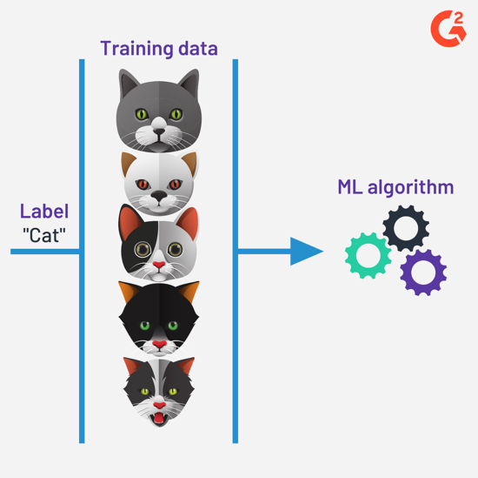
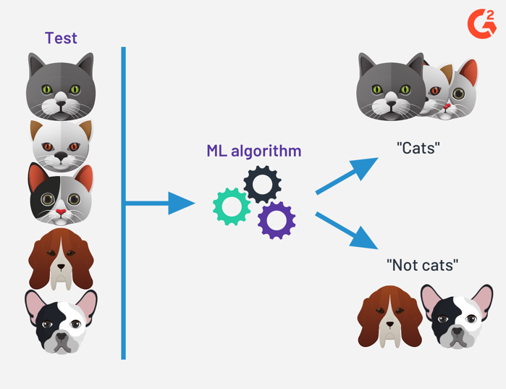
SUPERVISED LEARNING
We give the machine all at the answers
We train the model based on labelled dataset
Allows you to collect data and produce a data output from previous experiences
Helps you optimize performance criteria using experience
Example:
Machine has a basic idea of what a cat is based on the data and labels.

Slide 4
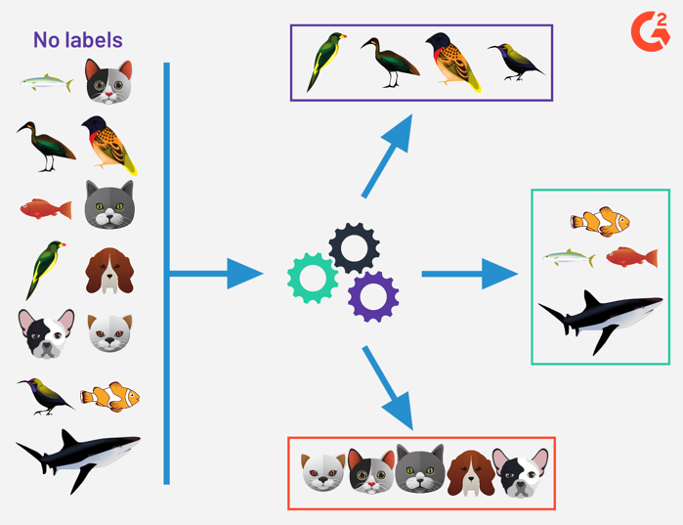
UNSUPERVISED LEARNING
You don’t need to supervise the model
You allow the model to work on its own to discover information
Main component is the unlabeled data
Allows you to perform more complex processing tasks
Easier to get unlabeled data from a computer than labeled data which needs manual intervention
Example:
We can see even without labels; the algorithm was able to sort the data based on the structure it identified

Slide 5
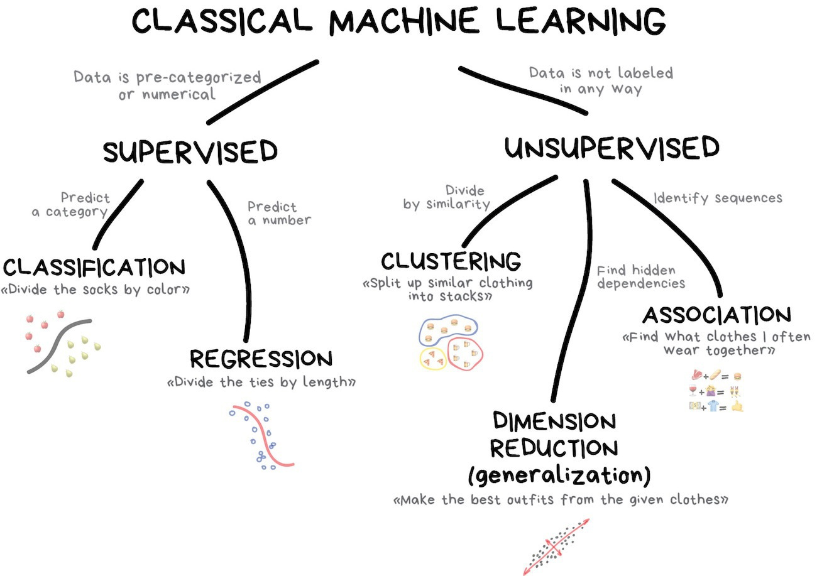

Slide 6
Why is machine learning important?
Data!
Data is growing everyday
There is so much unstructured data
The more the data, the higher the time it will take to compute
This is where machine learning comes into action

Slide 7
3 components to teach the machine

Slide 8
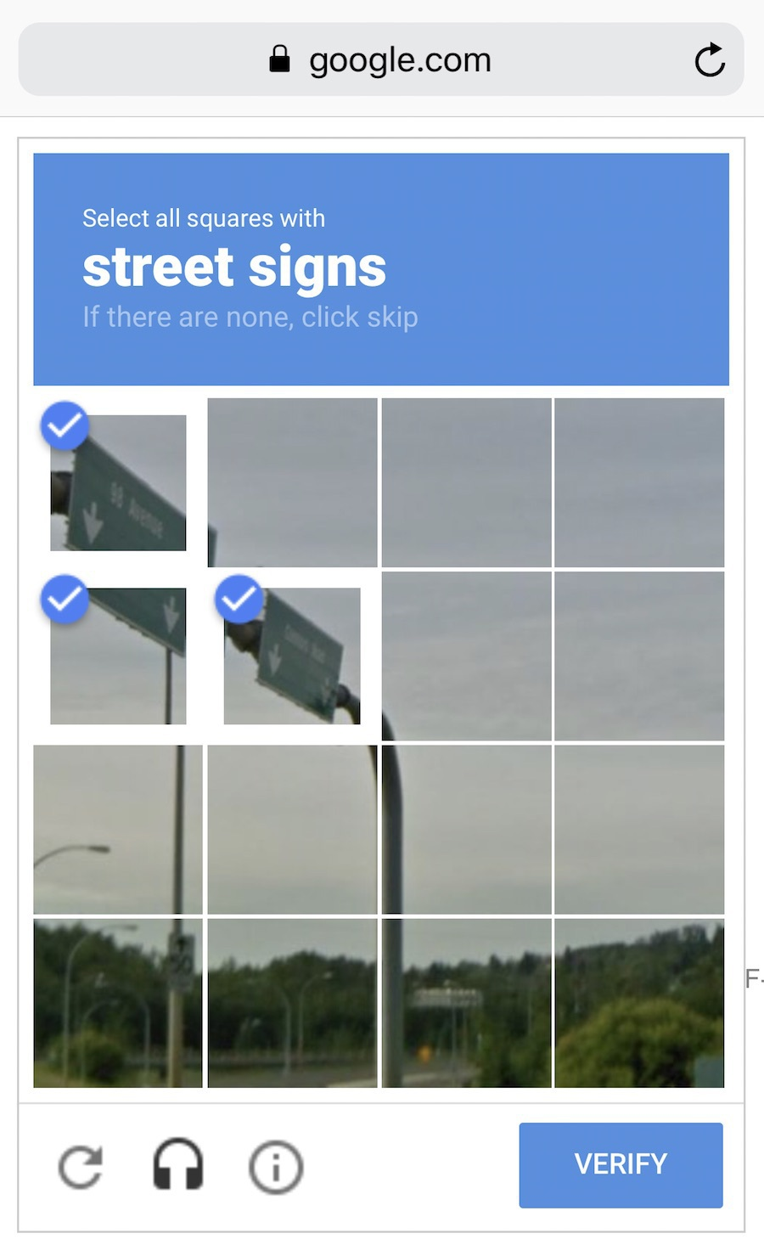
DATA
The more diverse the data, the better the result
How to collect data?
Manually
Contains far fewer errors
Takes more time
More expensive
Automatic
Gather everything you can find
Cheaper
Example: Google uses their own customers to label data for them. (ReCaptcha)

Slide 9
FEATURES
These are the parameters or variables
Features are the factors for a machine to look at.
Example: To predict the sale price of a house, you might consider some of these features:
size of the house
Number of bedrooms
Number of bathrooms
Year built

Slide 10
ALGORITHMS
Any problem can be solved differently
Method you choose affects:
The precision and accuracy
The performance
Size of the model
It is important to note that if data is weak, even the best algorithm won’t help

Slide 11
Machine learning applications
Financial services
Identify important insights
Identify investment opportunities
Help investors know when to trade
to prevent fraud
Retail
Websites recommending items you might like based on previous purchases
Personalizes shopping experiences
Healthcare
Wearable devices and sensors that can use data to assess a patient’s health in real time
Helps identify trends that may lead to improved diagnoses and treatment

Slide 12
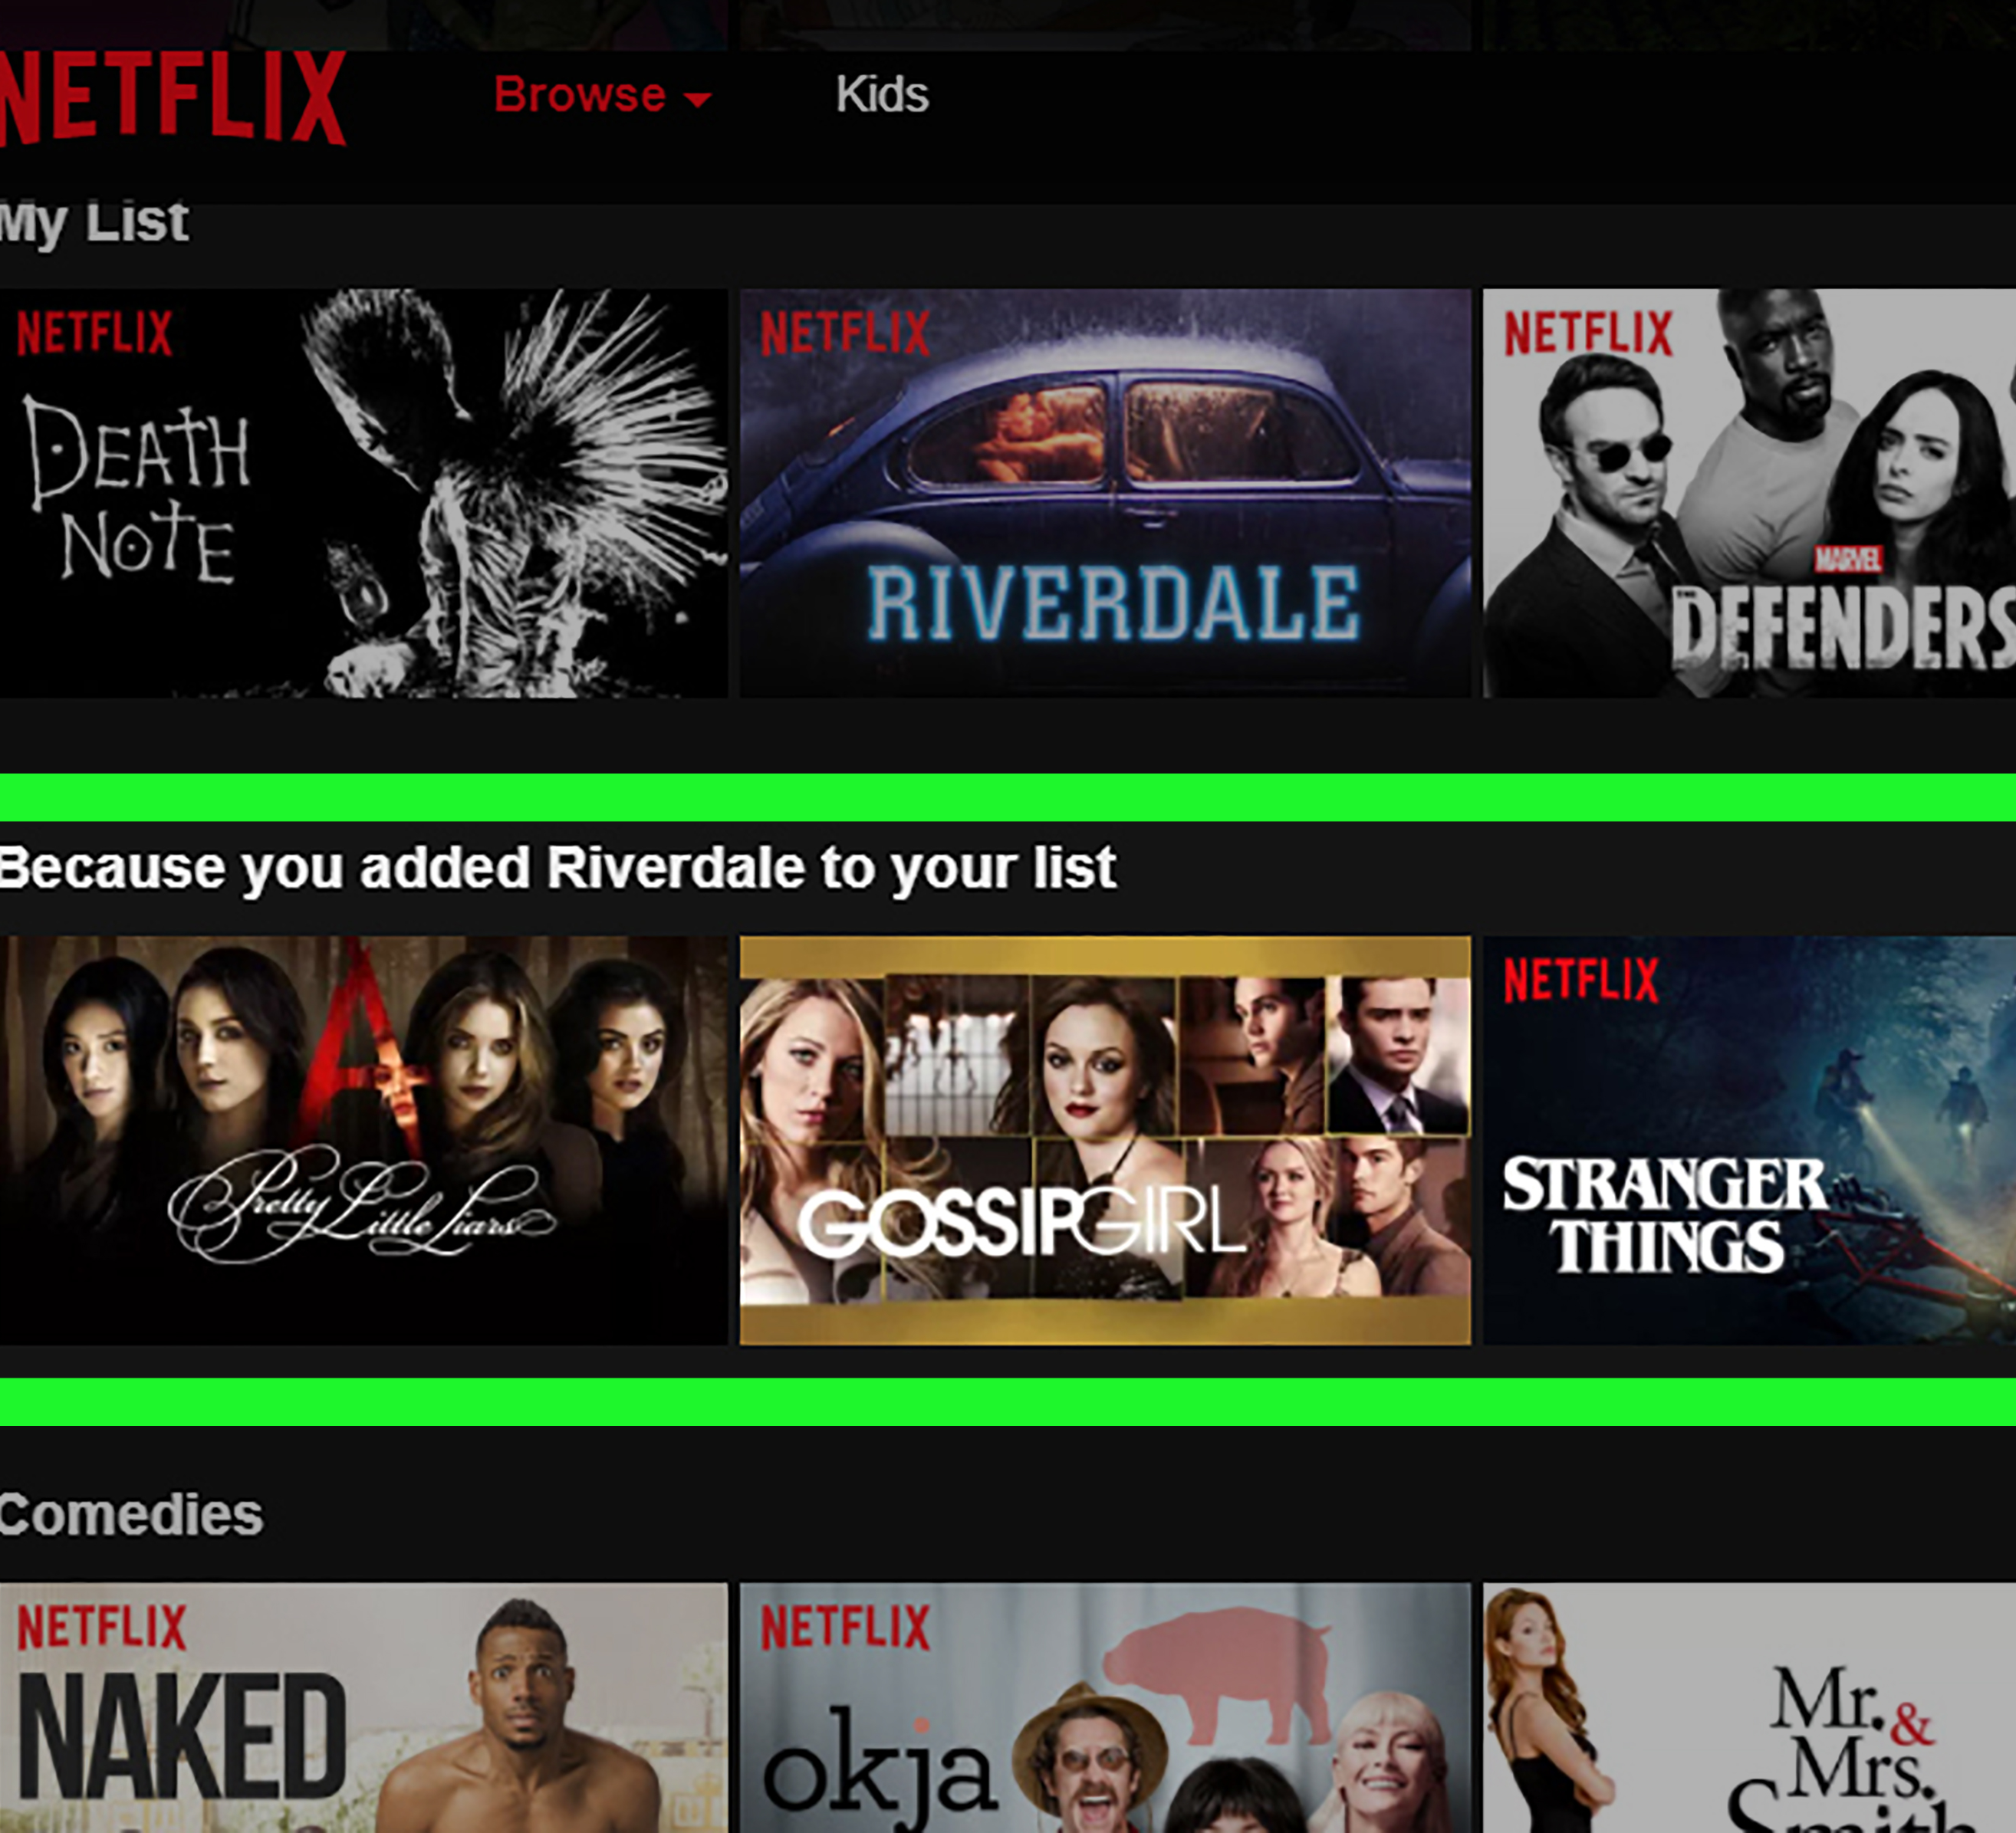
NETFLIX EXPERIMENT
In 2006, Netflix conducted a contest to improve the accuracy of predictions about how much someone is going to enjoy a movie based on their movie preferences
The data set consisted of:
100,480,507 ratings from 480,189 users gave to 17,770 movies
The members of BellKor's Pragmatic Chaos said they worked in different locations, collaborating mostly by e-mail. They met for the first time Monday morning before accepting the $1 million prize

Slide 13
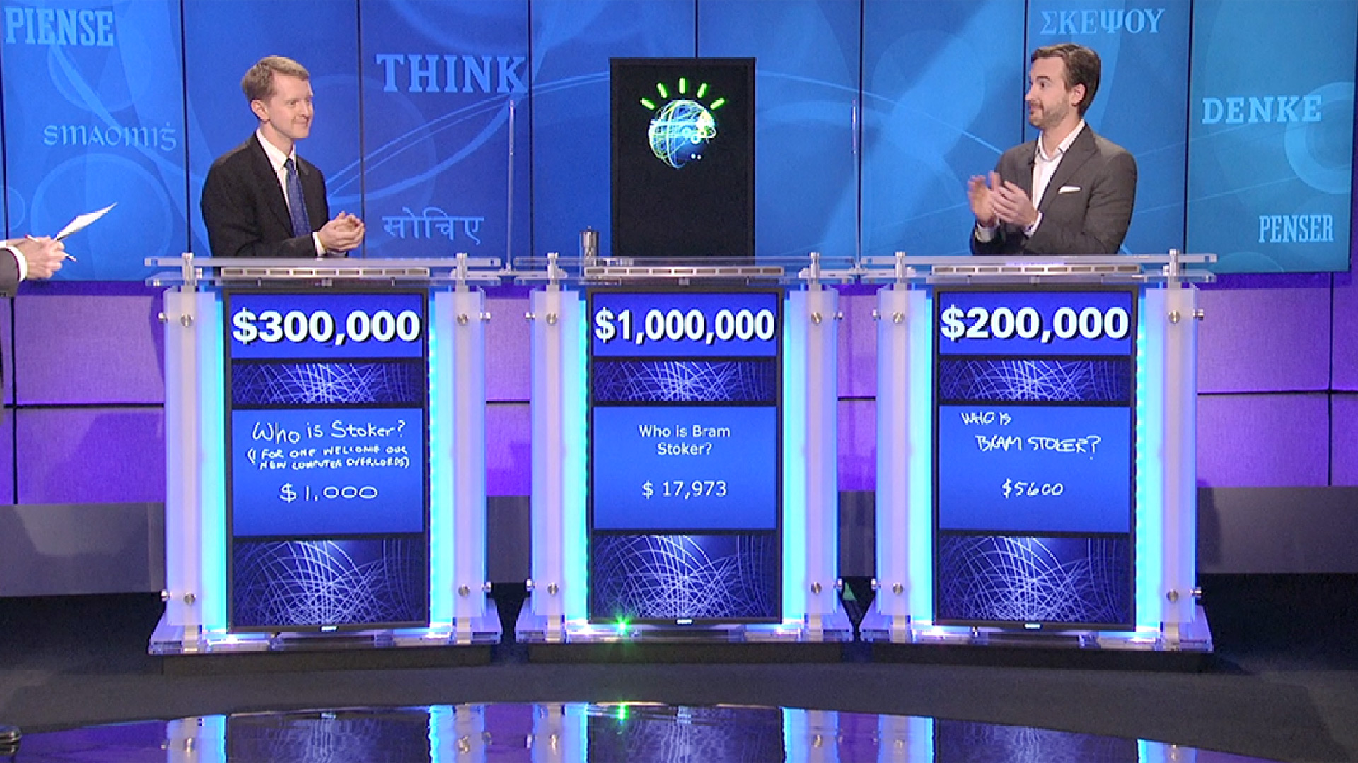
WATSON
A question-answering computer system developed by IBM
Experimented with several machine learning algorithms
Room for improvement: it was correct 71% of the time
Watson only trained with 25,000 questions

Slide 14
Future of machine learning
The global machine learning market was valued at $1.58B in 2017 and is expected to reach $20.83B in 2024
World economic forum states that the growth of machine learning could create 58 million new jobs by 2022

